Slide 1
Bethesda Soccer Club Managers Meeting
2019/2020

Slide 2





About Our Club
We are a 501c3 Not-for Profit Club Based in Montgomery County, Maryland, outside Washington DC
We are the Premier Travel and Youth Development Program in the region
Founded in 1979, as the Bethesda Boys Club with three teams, we have since grown to over 80 boys’ and girls’ teams from ages U8 through U18 and over 1300 players
Our teams compete in various leagues in Maryland, Virginia, Region I, and nationally
We are one of a handful of clubs in the country with both a US Soccer Development program and an ECNL program – the highest level of competitive play in the country for boys and girls respectively:
  We have five boys teams playing nationally in the US Soccer Development Academy (USSDA)
  We have six girls teams playing nationally in the Elite Club National League (ECNL)

Slide 3
Mission
The Bethesda Soccer Club (BSC) is committed to creating a competitive, supportive, challenging, and fun environment for all our players to reach their potential through the beautiful game of soccer.

Slide 4
Organization
Board of Directors
Office Manager
Older Girls (15-19) Director
Office Administrator
Director of Operations
Communications Coordinator
Technical Director
Younger Girls (12-14) Director
Girls YDP Director
Older Boys (15-19) Director
Younger Boys(12-14) Director
Boys YDP Director
Executive Director

Slide 5
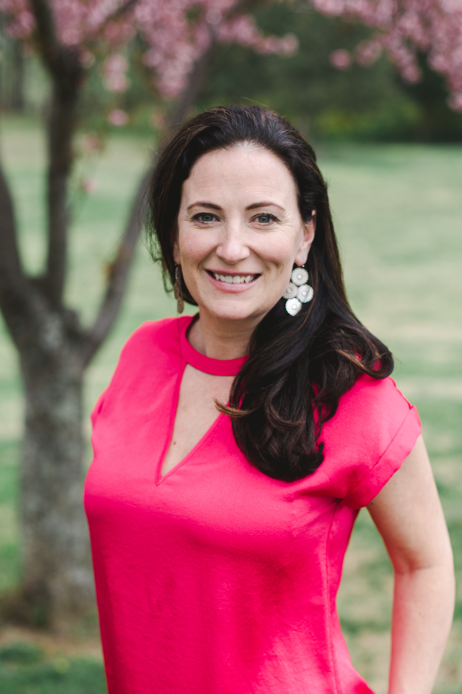
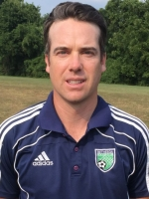
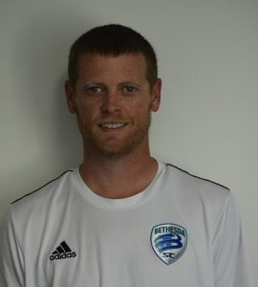
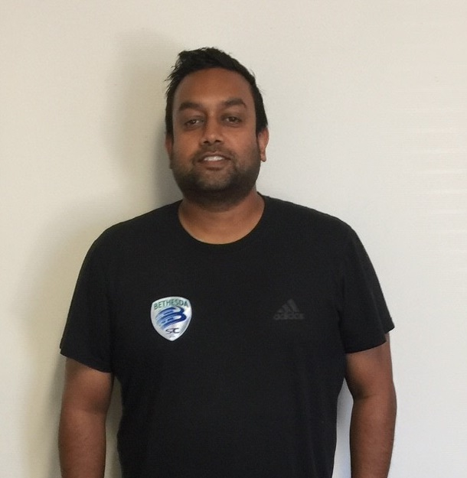
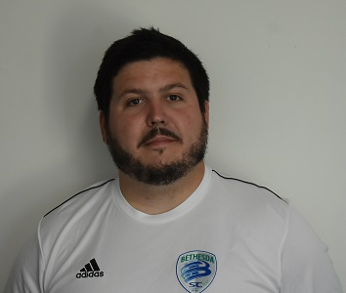
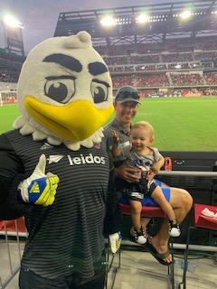
Organization
Lisa Frates
Executive Director
Jonathon Colton
Technical Director
Zane Campbell
Office Manager
Shawn Wijeratne
Director of Operations
Sean Maslin
Communications Manager
Linda Norton
Office Administrator

Slide 6
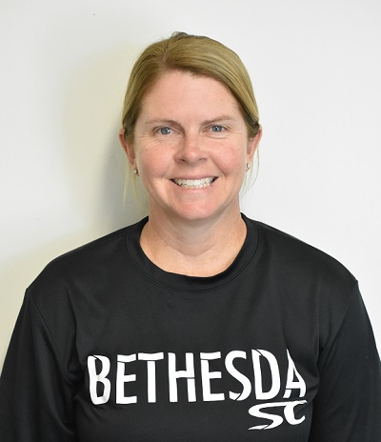
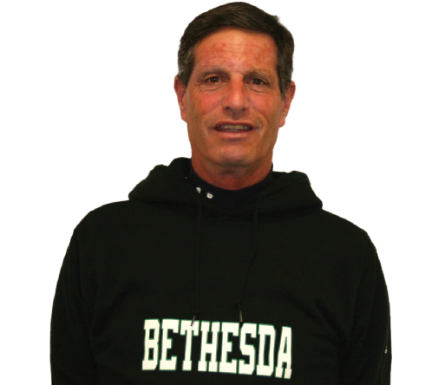
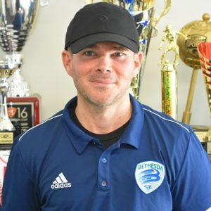
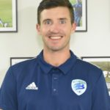
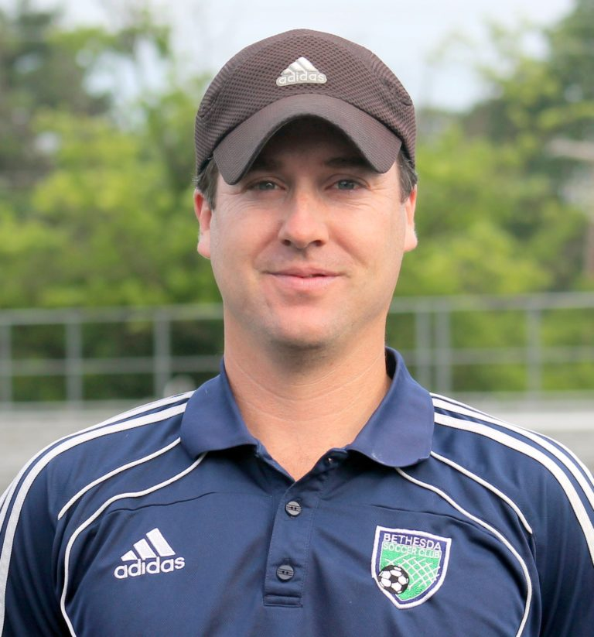
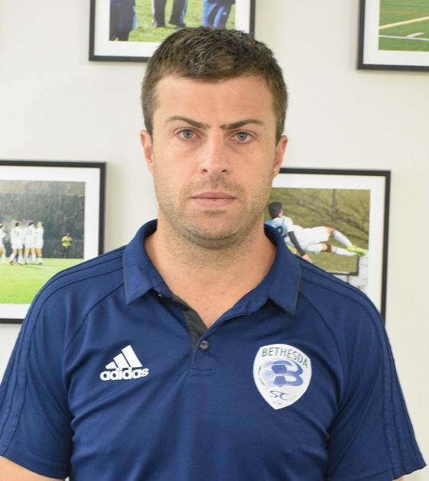
Organization
Emily Janss
Girls YDP Director
Dave Greene
Younger Girls Director 12-14
Kevin Layton
Older Girls/ECNL Director
Trevor Martin
Boys YDP Director
Brett Colton
Younger Boys Director 12-14
Matt Ney
Older Boys Director/DA Director

Slide 7
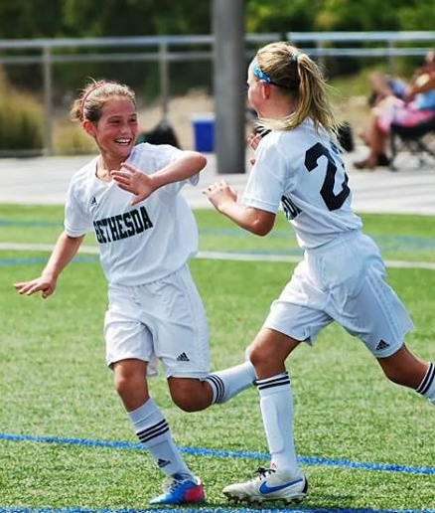
Philosophy Overview
“One Club” experience
Commitment to a holistic approach to long-term, elite player development
Develop, retain, and attract the highest quality coaches
Meritocracy and mobility for all of our players
Adapt, change, and grow when necessary
Notes:
“Hello, my name is Ellis Pierre and I’m the Director of Coaching of the girl’s program. Welcome to the 2014-2015 season town hall.”
"Spurred by the new mission & values statements for the club, combined with the feedback from parents in the survey, the DOC’s embarked on a sixty day process to “re-write” BSC’s coaching philosophy and policies for the club, as well as to come up with a plan that will achieve the objectives inherent in the mission statement of the club. This goals include…”
"Some youth academies worry about winning, we worry about education.”
-Xavi Hernadez
Barcelona and Spain Midfield Maestro

Slide 8
Style of Play
Philosophy:
Attacking Possession Soccer - Our players are required to play possession-oriented attacking soccer. Goalkeepers are encouraged to roll the ball to the feet of the defenders to initiate play. Teams are expected to play through the midfield through intelligent passing, combination play and effective decision-making.
Our playing philosophy outlines an overarching vision for the beautiful game.
  In possession:
    A possession-based approach played through the three-thirds of the pitch
    Quality passing and intelligent movement and support off the ball
    Penetrative, incisive and varied attacking play, allied to good finishing
    Counter-attacking whenever opportunities arise
  Out of possession:
    A tactical approach to defending, in which all players contribute
    A controlled, calculated and assertive approach when and where necessary
Additionally, the playing philosophy actively encourages the individualistic player. Players with varied and unique dribbling skills and the dexterity to go past defenders, particularly in the final-third, are fundamental to success in the future game

Slide 9
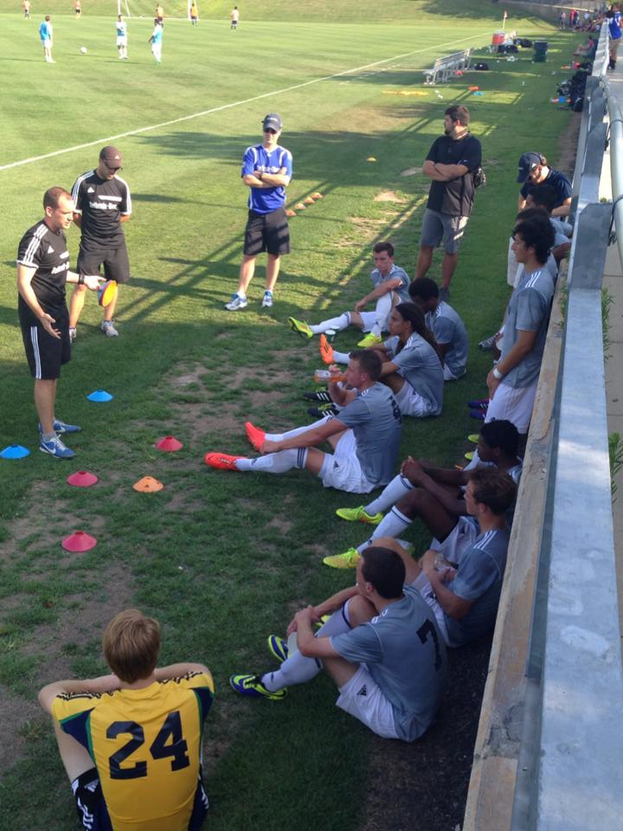
Coaching Philosophy
One Club Philosophy
Quality Training
Age Appropriate Curriculum
Having Fun and Inspiring your Players
Prioritized Development while teaching kids to compete to win
Notes:
The 4 core areas we will be focusing on for the 2014/2015 are…

Slide 10
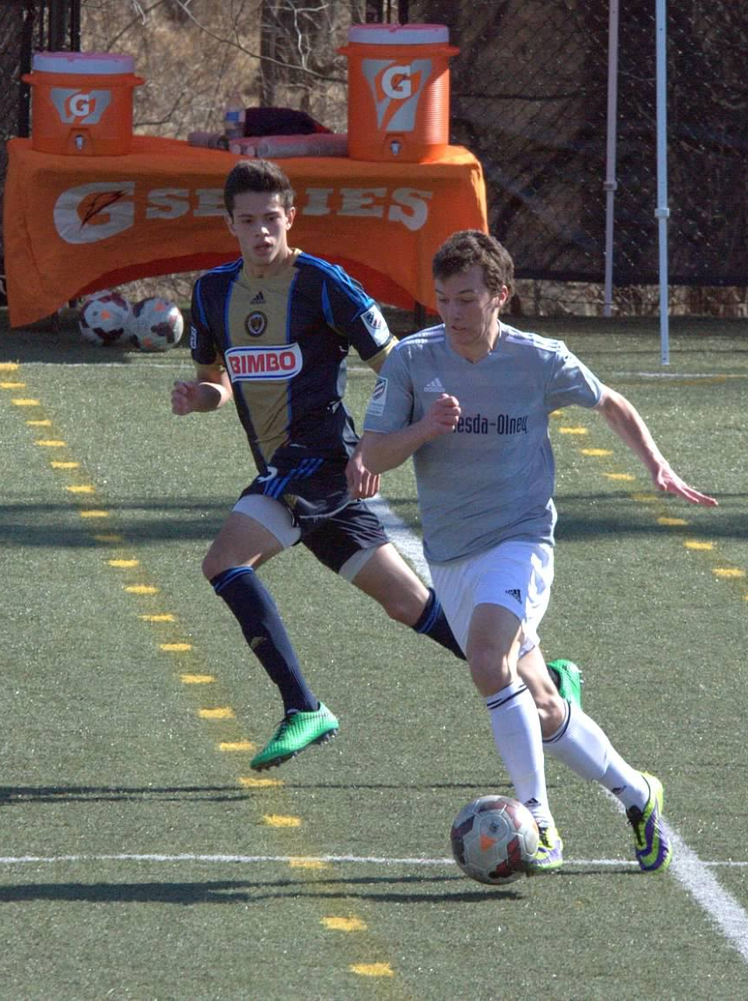
Prioritized Development
Player development and playing experience are a prioritiy while striving for team success
BSC believes that teams will win if they focus on cultivating the right player development environment
The target record for Bethesda SC teams is a 6-3-1 ratio
We structure teams based on “current” abilities starting at U9 for boys and girls. We provide meritocratic environment and strive for mobility between teams.
We have strict policies on starts and related playing time to ensure all players get significant game development
Players should play 2/3 different positions until U13 when they start to specialize in a position.
Notes:
Teams should be in leagues that fit their team composition-teams should challenged enough that they aren’t winning every game, but should definitely win more than they lose
By Academy level target record is winning every game

Slide 11
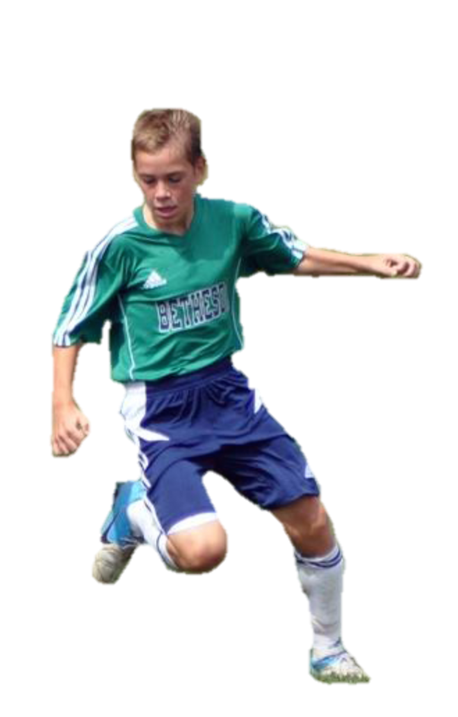
Player Values
Teamwork
  Enthusiastic
Courageous
  Committed
  Studious
Confident
  Positive
  Loyal
  Charitable
Notes:
All our players, coaches, and parents should try and embody the club’s key values.

Slide 12
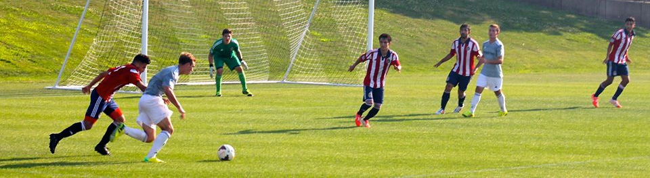
Players Code of Conduct
Stay committed to the BSC style of play
Embody a confident mindset in all activities
Be respectful and professional on and off the field at all times
Maintain a high level of fitness and nutrition
Commit to year-long playing calendar
Display positive attitude
Notes:
Through soccer, we would like to instill core values in our players not only as soccer players but as people
There are so many lessons to be learned through soccer and BSC wants to help in that learning process

Slide 13
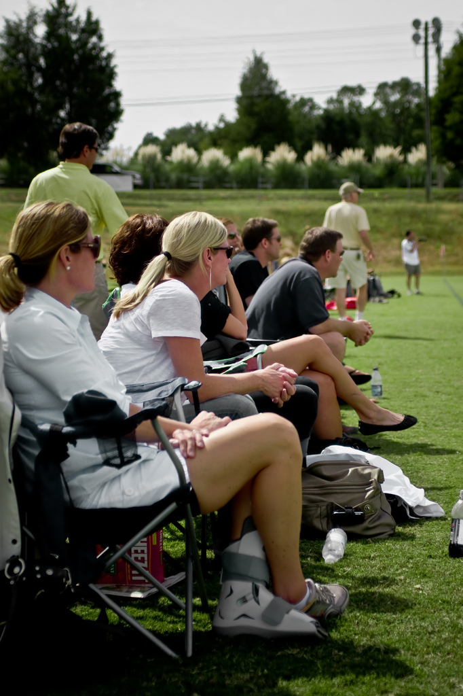
Parents Code of Conduct
Parents are a key element in the Bethesda Soccer Club and their support of the club is essential. Parents are expected to:
Commit to positive sideline behavior
Provide positive encouragement without attempting to coach players
Not contact coaches until after 48 hours from the time of the game
We recommend parents to ‘Drop Off’ their children at practice.
Notes:
The 24 hour rule allows conflict to be resolved and concerns to be heard while bringing down the level of conflict
Parents should not try to win favoritism with coaches via gifts, etc. or provide negative pressure to alter the natural placement of kids, etc.

Slide 14
Inclement Weather Policies
:
Information on cancellations, delays, or rescheduling will be available via TeamSnap and the BSC website
  No news is good news!
Excessive Cold
  Wind chill below 25 degrees
Excessive Heat
  Wet Bulb Globe Temperature over 92
Rain
  Coaches decision/facility policy
Lightning
  Immediately vacate the field. Return 30 minutes after last strike or boom

Slide 15
Fields
:
Field Inventory
  Montgomery County Public Schools
  Area Private Schools
  Recreational Field
Cancellations and Field Closures
  Facility Policy
  Coaches or Referees
  Accommodations and Alternatives
  Always check with your coach. A closed field does not mean no practice.

Slide 16


















College Placements
Notes:
The 24 hour rule allows conflict to be resolved and concerns to be heard while bringing down the level of conflict
Parents should not try to win favoritism with coaches via gifts, etc. or provide negative pressure to alter the natural placement of kids, etc.

Slide 17












College Placements
Notes:
The 24 hour rule allows conflict to be resolved and concerns to be heard while bringing down the level of conflict
Parents should not try to win favoritism with coaches via gifts, etc. or provide negative pressure to alter the natural placement of kids, etc.

Slide 18
Club Benefits
:
Soccer Parenting Association-Free Membership
SportsRecruits College Software (U15 and above)
Player Insurance
Family Discount at PJ Sports
Individual Player Training with renowned Head Coach Phillip Gyau
Healthy Baller

Slide 19
Upcoming events
:
September 28th Washington Spirit Night at Maryland SoccerPlex
Friday October 18th Maryland Men’s Soccer Night against Indiana University
Late October/Early November-College Recruiting/Application Seminar
February-Soccer Health and Nutrition Seminar

Slide 20
:
Thanks for joining us!

